Slide 1
Dynamic Analysis Overview
Charles Wilson
Staff Product Cybersecurity Architect
version 6
2025-08-26
Notes:
Script:
I'm Charles Wilson, staff product cybersecurity architect at Torc Robotics.
This presentation will cover an overview of Dynamic Analysis.

Slide 2
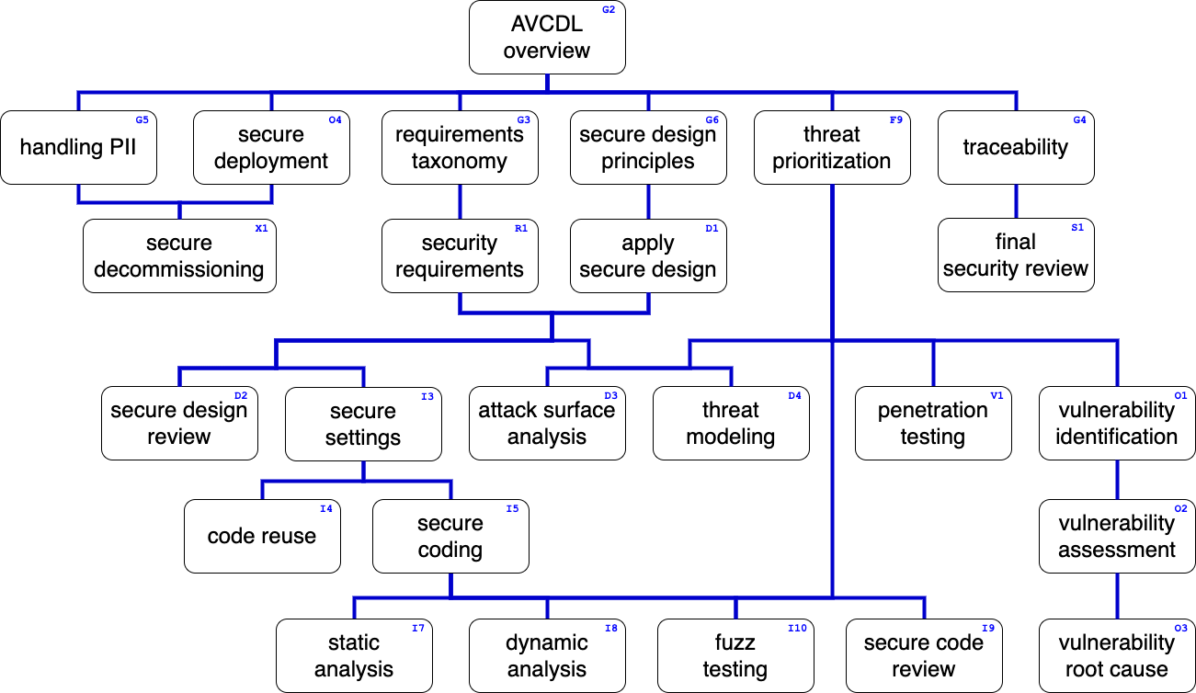
Training Path
Notes:
Script:
This diagram shows the overall AVCDL training path.
If you're taking this training, it's assumed that you've already completed the AVCDL Overview training,
and additionally, that you've completed the
Requirements Taxonomy
Security Requirements
Secure Design Principles
Apply Secure Design
Threat Prioritization
Secure Settings
and
Secure Coding
trainings.
This training will cover Dynamic Analysis.

Slide 3

Introduction *
* Neutral Buoyancy (link in references)
Notes:
Script:
Before sending people and new equipment out into space, NASA has them spend time at their neutral buoyancy laboratory.
This is a huge water tank used to simulate a low gravity environment.
It allows them to put people and systems through their paces.
The reason for this is that the stakes are very high and there's little margin for error.
This system allows them to test specific aspects of the equipment that they've created in situations where, should a failure occur, they're monitoring it and can respond quickly to make corrections before it ever sees the field.
This is the role within system development that dynamic analysis plays.
It allows us to select specific areas within the software, put them under particular types of stress, and look at how they behave in order to determine whether or not there are issues that need to be addressed before we release the system.

Slide 4
Types and Tools
Notes:
Script:
Before we get into the process of dynamic analysis, let's consider some dynamic analysis types and tools that are of interest within the context of cybersecurity.

Slide 5
Dynamic Analysis Types
Code coverage
Concurrency errors
Fault localization
Invariant inference
Memory error detection
Performance analysis
Program slicing
Security analysis
Notes:
Script:
One of the main things distinguishing dynamic analysis from static analysis is that dynamic analysis requires that we actually run code, where static analysis is simply reasoning on the code.
This is an important distinction when we think about the kinds of analysis that we do.
We can consider things like code coverage. Are we actually exercising all of our code?
[pause]
We can think about concurrency issues.
[pause]
We can think about fault localization, which tends to be a more manual activity.
[pause]
We can talk about invariant inference where we've got what appears to be complex code, but in actuality has a very static behavior.
[pause]
We have memory error detection.
We think about this a lot because if there are errors in memory, we’ll have bad behavior.
[pause]
We can talk about performance analysis where we're looking at how the system as a whole acts both in terms of time and resources.
[pause]
There's program slicing where our interest is in how we can make the program as small as possible and still have it do what it's supposed to do.
[pause]
And finally, there's a type of security analysis which is looking at the behavior of the code as it's running with respect to cybersecurity.
[pause]
Our focus is primarily on memory error detection.
Let's consider what tools are available for that type of analysis.

Slide 6
Memory Error Detection Tools
Tool | Area
ASan | Address management
MSan | Memory initialization
LSan | Memory leaks
TSan | Thread management
UBSan | Undefined behavior
Notes:
Script:
There are five tools that we're going to consider when talking about dynamic analysis memory error detection.
These are:
• ASan, which looks at address management
• MSan, which considers memory initialization
• LSan, which looks for memory leaks
• TSan, which is concerned with thread management
and finally
• UBSan, which looks for undefined behavior
The San in all of these is short for sanitizer.
These tools are available for most platforms and tool chains of interest.
We won't be going into any more depth on these.
That's left to other trainings.

Slide 7
Workflow
Notes:
Script:
With the background material out of the way, we'll now look at the workflow involved in the dynamic analysis process and then examine each of the activities it contains.

Slide 8
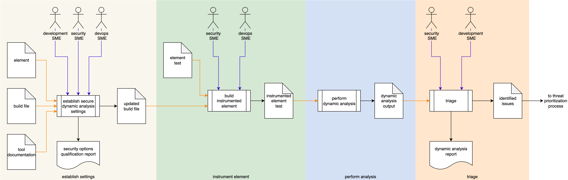
Process Workflow
Notes:
Script:
The workflow for performing the dynamic analysis process is broken down into four discrete activities.
These are:
• establishing the cybersecurity relevant settings
• instrumenting the element
• performing the analysis
and finally
• conducting a triage of the issues identified as a result of the analysis

Slide 9
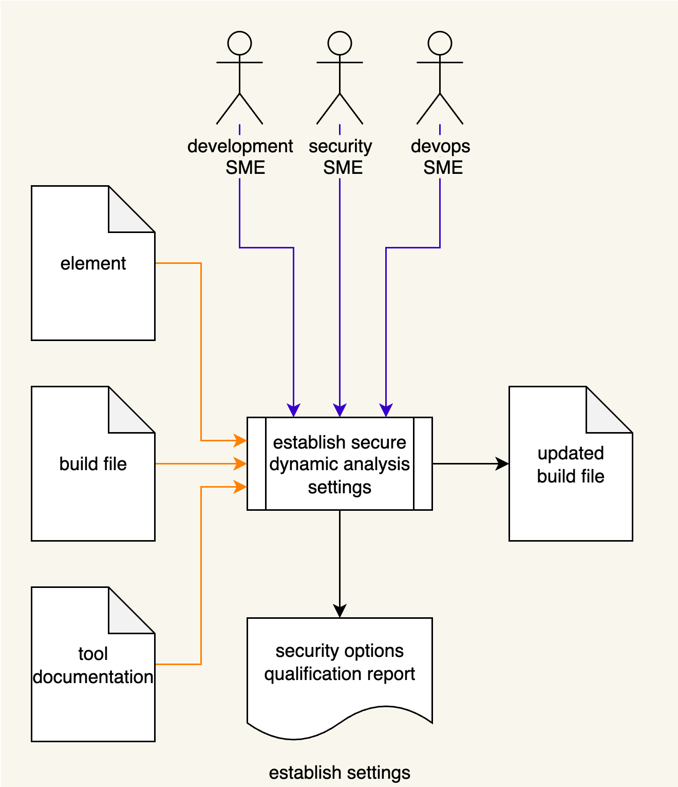
Establish Settings
Notes:
Script:
The workflow for performing the dynamic analysis process is broken down into four discrete activities.
These are:
• establishing the cybersecurity relevant settings
• instrumenting the element
• performing the analysis
and finally
• conducting a triage of the issues identified as a result of the analysis

Slide 10
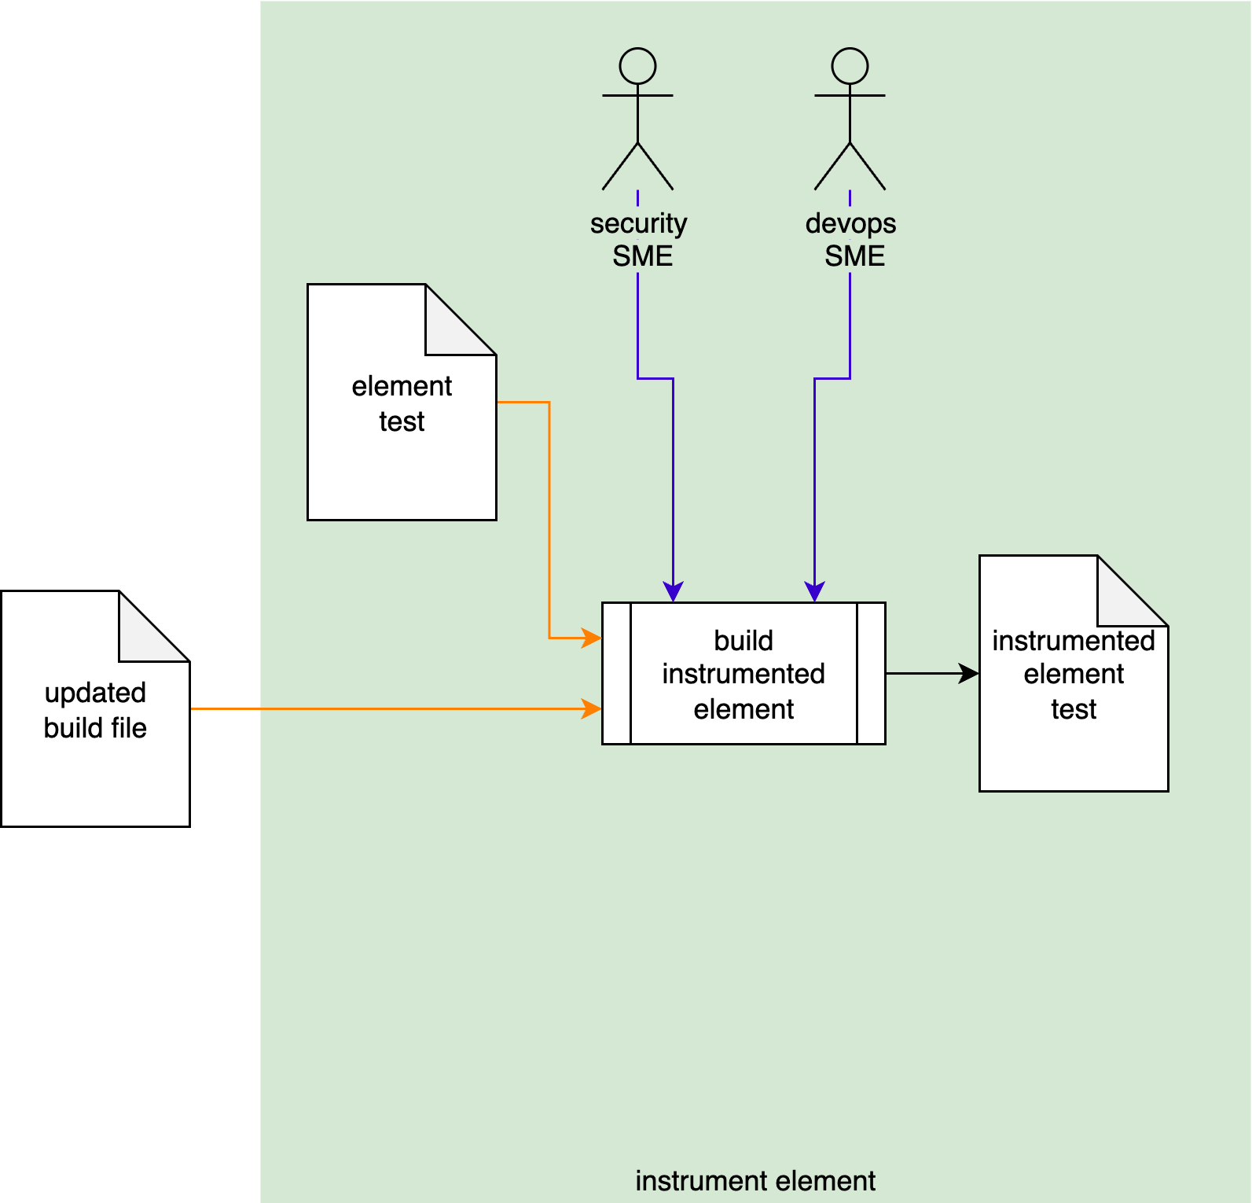
Instrument Element
Notes:
Script:
The workflow for performing the dynamic analysis process is broken down into four discrete activities.
These are:
• establishing the cybersecurity relevant settings
• instrumenting the element
• performing the analysis
and finally
• conducting a triage of the issues identified as a result of the analysis

Slide 11

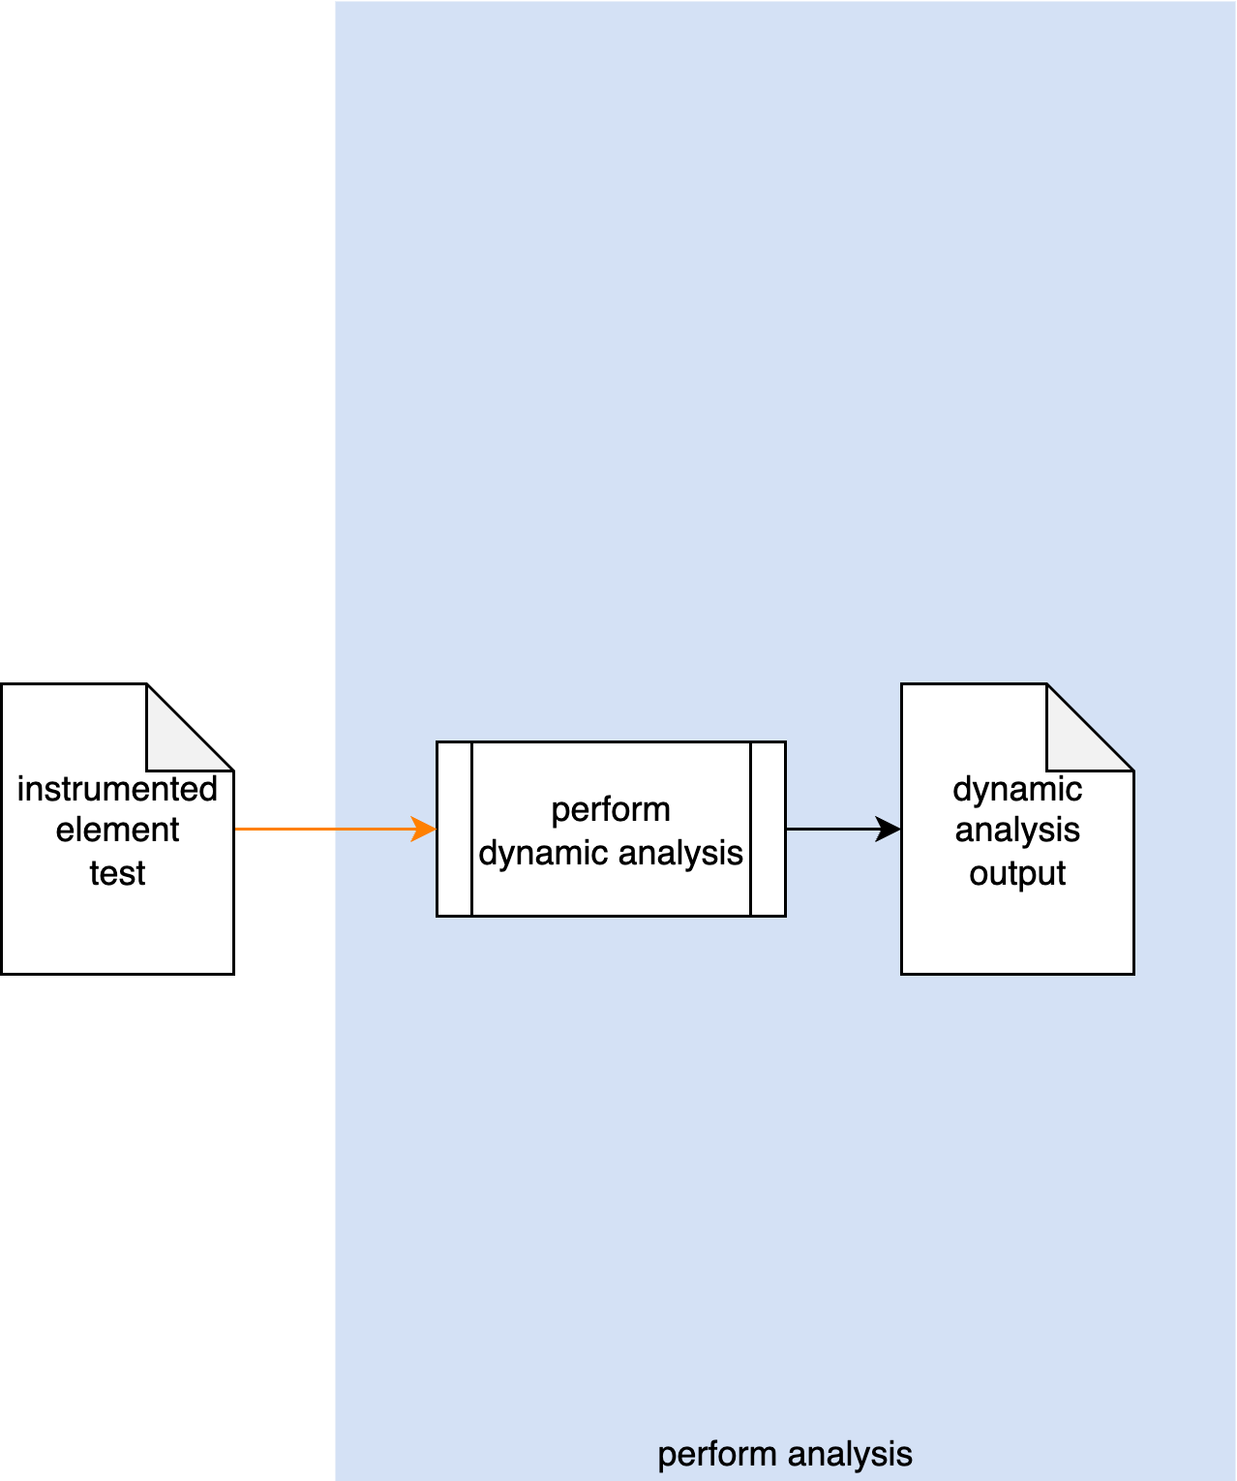
Perform Analysis
Notes:
Script:
The workflow for performing the dynamic analysis process is broken down into four discrete activities.
These are:
• establishing the cybersecurity relevant settings
• instrumenting the element
• performing the analysis
and finally
• conducting a triage of the issues identified as a result of the analysis

Slide 12
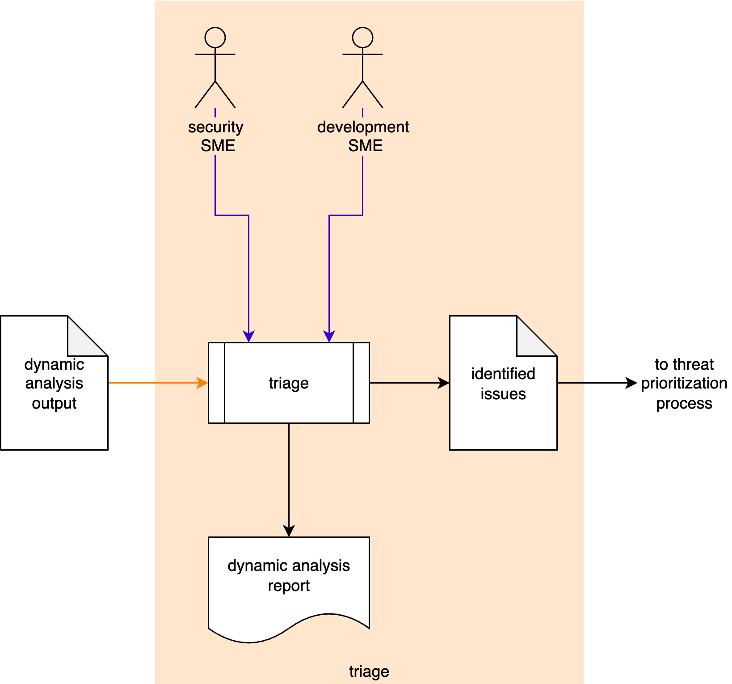
Triage
Notes:
Script:
The workflow for performing the dynamic analysis process is broken down into four discrete activities.
These are:
• establishing the cybersecurity relevant settings
• instrumenting the element
• performing the analysis
and finally
• conducting a triage of the issues identified as a result of the analysis

Slide 13
Activities
Notes:
Script:
Let's now turn our attention to each of the activities that go into the dynamic analysis process.

Slide 14
Establish Settings
Execution time
Footprint
Notes:
Script:
Our first activity in the dynamic analysis process is that of establishing the settings we'll use.
Now, the activity itself will include a development SME, a cybersecurity SME, and a devops SME.
[pause]
They're going to take the element, the build file, and the documentation,
[pause]
and establish a set of settings to be used.
[pause]
These will put into an updated the build file
[pause]
and produce a security options qualifications report.
Now if this diagram seems really information-dense, that's because this is the encapsulation of the secure settings process, and we're not going to cover that here.
Because we're impacting the build, it's important to consider the
[pause]
execution time
[pause]
and footprint
The reason for this is that since dynamic analysis is part of the test suite to be executed, it may well be time bounded.
And so, it's important to consider how that time bounding will be impacted by the addition of the dynamic analysis task.
The same thing is true for the footprint.
If you have instrumentation that's put into a test and attached to an element, regardless of what the scope of that element is, you may run into boundary conditions for the particular system the code is running on, and you have to be cognizant of that.

Slide 15
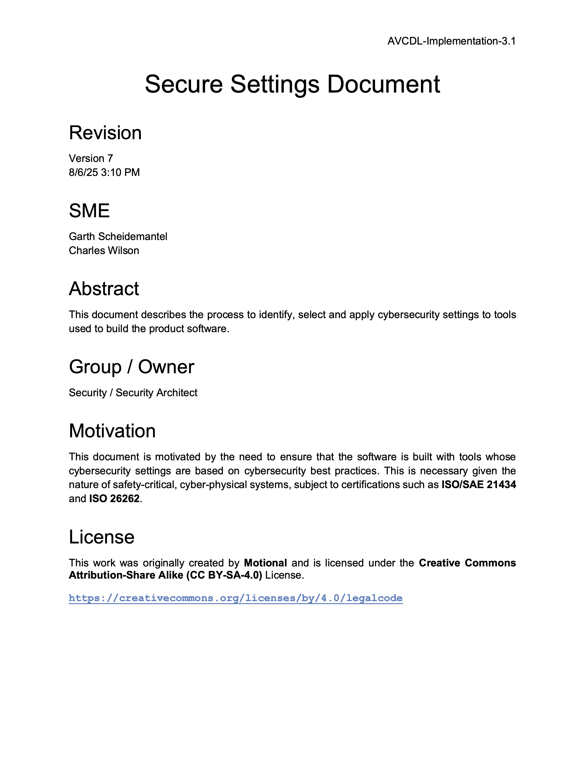
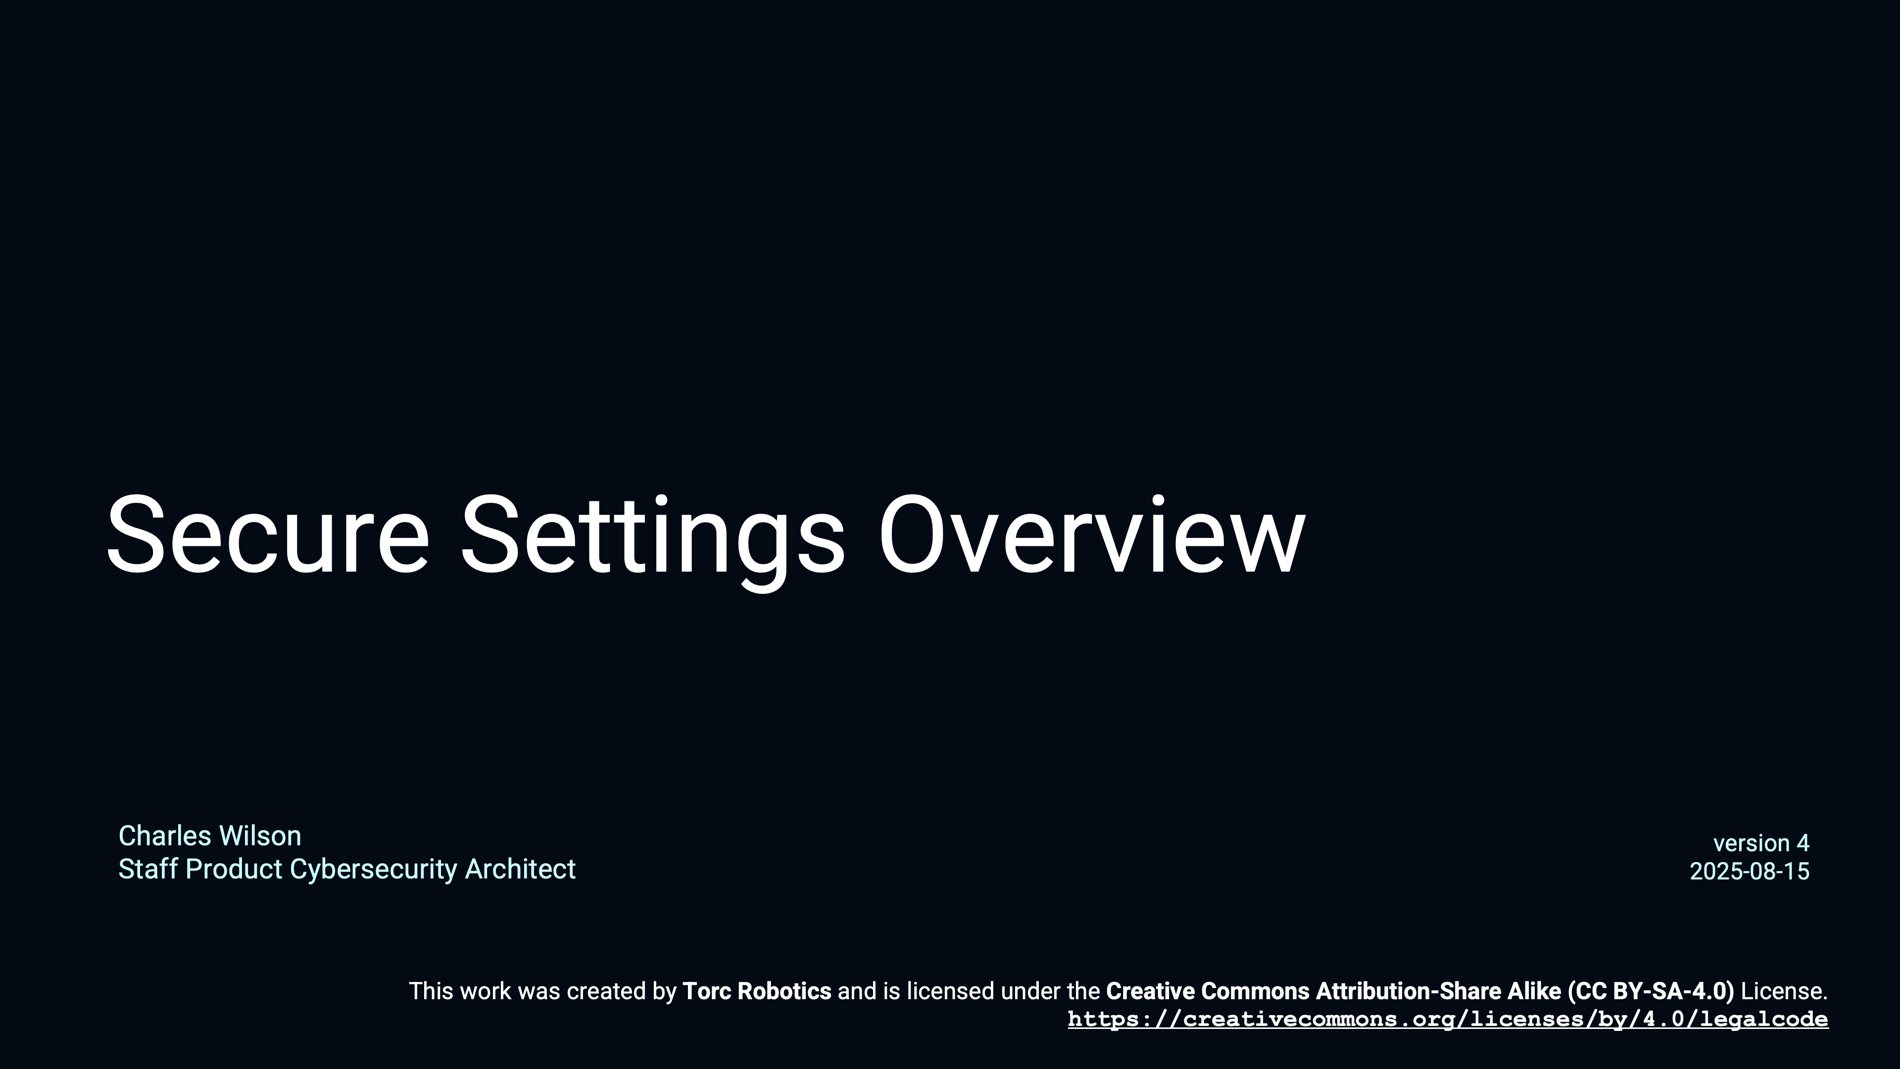
Secure Settings
Notes:
Script:
Rather than rehash a subject that is covered separately, here are some references to review secure settings in more detail.
They are the Secure Settings Overview training video, and the Secure Settings Document, secondary document.

Slide 16
Instrument Element
Overlay existing test
Possibly fully automatic
Notes:
Script:
The next step in the process is to instrument the element test.
The security SME and devops SME take the element test and updated build file and construct an instrumented element test.
It’s important to emphasize that generally what we're doing is really overlaying an existing test with instrumentation to allow the dynamic analysis tool to run against the element.
In some cases, this step may be fully automated.
That's to say that we have the build file with updated settings.
We know the object that we're going to be dealing with and can just let it go through its cycle and generate an instrumented element test.
It may be the case that there is no existing test, in which case a test needs to be written.
Either way it's important to recognize that tests don't magic themselves into existence.

Slide 17
Perform Analysis
Orthogonal
Temporally-coupled
Timely
Notes:
Script:
The third activity in the dynamic analysis process is to perform the analysis.
We're taking the instrumented element test which will perform the analysis and generating output.
It’s important to consider that we're generally not using just one tool, and a single element is not usually going to be the limit of our interest when looking at how a given tool performs against the system.
With this in mind, you should treat all of your tools and all of your elements where possible, as orthogonal.
That's to say that when you're doing an analysis run, it's not covering everything.
And by the same token, you want to make sure that multiple runs will yield you the coverage that you want.
So, it's important that there be some temporal coupling the analysis runs.
The reason for this is that code base is not static over time.
It's important that when you're analyzing an element, that you're analyzing it to the extent that you're able with multiple tools and to that end, it's important that you do this in a timely fashion.
You don't want to do a dynamic analysis run that's looking at a particular aspect of memory initialization and then wait three weeks before you look at the memory leaks, because these are related and coupled activities.
Also, it's important to consider that because the code changes, that were you to do a memory leaks analysis a long time after you've done the memory initialization analysis, that you're possibly going to have new issues from analysis that you ran first.

Slide 18
Triage
File issues immediately
Tool false positives
Notes:
Script:
The final activity in the dynamic analysis process, as with so many AVCDL processes, is that of triage.
The cybersecurity SME and their development SME counterpart will take the dynamic analysis output and triage it.
The issues found to be valid are placed into an identified issues list, which is then sent to the threat prioritization process and a dynamic analysis report is generated.
Some may consider having to put each issue through the threat prioritization process as excessive for issues which typically result from execution termination.
Depending on how the organization implements their processes, it’s possible that issues may be entered directly to the issue tracking system instead of passing them to the threat prioritization process where the nature of the issues is unambiguous.
Additionally, if you're performing a triage, and discover that a tool is reporting an excessive number of false positives, then you should review the settings being used and ensure that they’re appropriate. If necessary, remove those settings which yield incorrect results.
Don't consider settings to be locked down, because at some point, those settings may need to change.

Slide 19
Dynamic Analysis Report
tool
element
results
Notes:
Script:
When we consider what goes into the identified issues, and in fact, into the dynamic analysis report by extension, there are three fundamental pieces of information that need to be there.
The first is the tool.
This may seem a bit on the pointless side, but you have to consider that there's not just one dynamic analysis report that will ever be generated.
There are a multitude of them.
And so, as this information is entered into the issue tracking system, and as it goes through threat prioritization processes, even as it's read, it's critical to know what tooling is being used.
This extends beyond just its name; there’s a whole host of information needed to identify what was used to perform the analysis.
The next thing to consider is the documentation of the element.
You may have gone through the exercise of deciding what the scope is, and instrumenting it and such, but as it's conveyed from the process to other individuals, It's important that it be documented in a way that allows others to easily locate it.
Finally, have the actual results.
In the case of dynamic analysis, as opposed to other types of analysis we do, the results may contain only one issue because by nature dynamic analysis runs to failure.
The takeaway is that we need to make sure we're including all of the information necessary for someone to both replicate and resolve the issues.

Slide 20
Recap
Notes:
Script:
That's an overview of the process used in performing dynamic analysis.
Now let's review what's been covered.

Slide 21
Summary
Select the tools
Instrument appropriately
Triage the results
Report the findings
Notes:
Script:
As we've seen, the dynamic analysis process is fairly straightforward.
We're going to start by selecting the tool or tools we're going to use.
We're going to make sure that we're instrumenting appropriately so that we are getting the tool to give us type results we are interested in.
Once we get the results, we're going to triage them.
And finally, we're going to report those findings in both the human readable and machine readable form.
The latter because we want to automate our processes where possible.

Slide 22
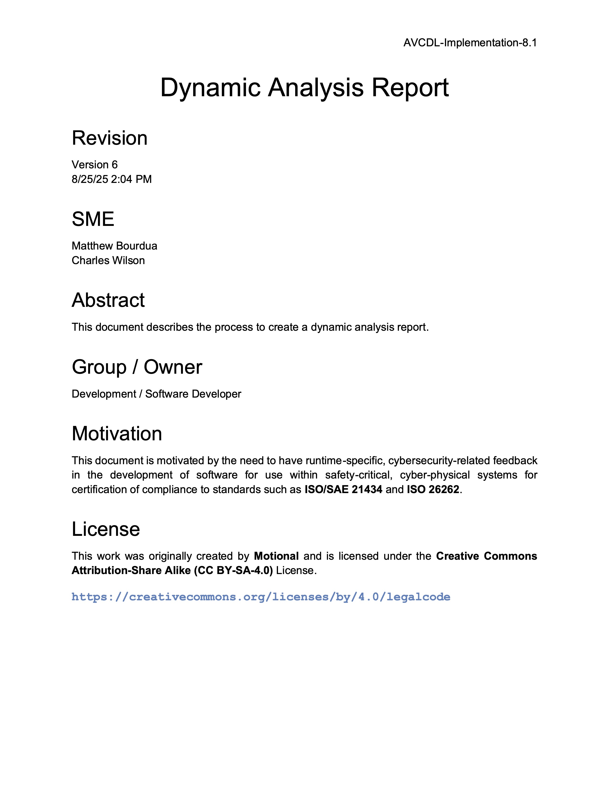
Further Reading
Notes:
Script:
For more information, and to get a more in-depth set of references, the Dynamic Analysis Report secondary document is available in the AVCDL GitHub repository.

Slide 23
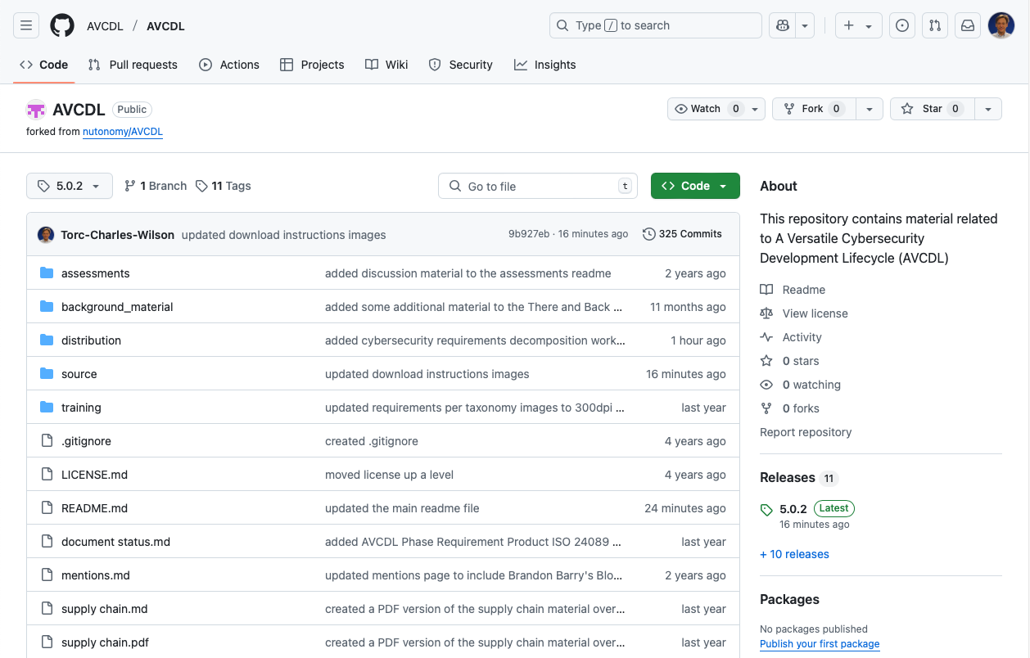
AVCDL on GitHub
https://github.com/AVCDL/AVCDL
Notes:
Script:
All AVCDL materials, both in source and distribution forms, are available on our GitHub site, as shown here.
Because of the size of the repository, it's recommended that you either clone the repository or download a ZIP archive of it, if you're not familiar with using git.
Instructions for downloading a ZIP archive are linked to on the repository’s front page.

Slide 24
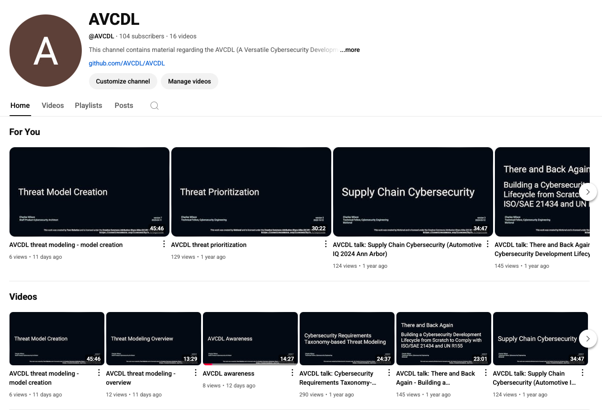
AVCDL on YouTube
https://youtube.com/@AVCDL
Notes:
Script:
Videos covering various aspects of the AVCDL are available on our YouTube channel, as shown here.
It's important to note that all AVCDL materials with the exception of the introductory blog posts are intended for product cybersecurity engineering practitioners.

Slide 25
Next Steps
Notes:
Script:
With this training complete, you can proceed to the other trainings at this level, these include:
Static Analysis
Fuzz Testing
and
Secure Code Review

Slide 26
References (1 of 2)
Secure Settings Document (AVCDL secondary document)
Fuzz Testing Report (AVCDL secondary document)
Static Analysis Report (AVCDL secondary document)
Security Options Qualification Report (AVCDL tertiary document)
Static Analysis Results Interchange Format (SARIF) Version 2.1.0
https://docs.oasis-open.org/sarif/sarif/v2.1.0/os/sarif-v2.1.0-os.pdf
Dynamic Program Analysis
https://en.wikipedia.org/wiki/Dynamic_program_analysis
Program Instrumentation Options [GCC]
https://gcc.gnu.org/onlinedocs/gcc/Instrumentation-Options.html
Address Sanitizer [LLVM]
https://clang.llvm.org/docs/AddressSanitizer.html
Thread Sanitizer [LLVM]
https://clang.llvm.org/docs/ThreadSanitizer.html
Notes:
Script:
Here are the references to the source material used in the creation of this presentation.
They'll also be included in the video description.
Additionally, this presentation’s source material will be provided on the AVCDL GitHub repository.

Slide 27
References (2 of 2)
Memory Sanitizer [LLVM]
https://clang.llvm.org/docs/MemorySanitizer.html
Leak Sanitizer [LLVM]
https://clang.llvm.org/docs/LeakSanitizer.html
Undefined Behavior Sanitizer [LLVM]
https://clang.llvm.org/docs/UndefinedBehaviorSanitizer.html
Neutral Buoyancy
https://www.nasa.gov/wp-content/uploads/2020/05/neutral_buoyancy_-_resized_1.jpg
Notes:
Script:
Here are references to the source material used in the creation of this presentation.
They'll also be included in the video description.
Additionally, this presentation’s source material will be provided on the AVCDL GitHub repository.

